Slide 1

Team Name : IT SQUAD
Team Leader Name : Gopika G S
Problem Statement : Food is wasted because people don’t know what to cook with what they already have.

Slide 2

Brief about the Idea:
Problem
Households waste large amounts of food due to forgotten ingredients, poor inventory tracking, and lack of recipe ideas, while existing recipe applications work one-way requiring manual ingredient entry and offering generic, keyword-based suggestions that fail to understand real household situations, leading to financial loss and environmental impact.

Slide 3
Why The Zero-Waste Chef?
How is it different from existing solutions?
• Existing recipe apps require manual ingredient entry.
• Smart kitchen apps depend on expensive IoT devices or smart appliances.
• Food waste trackers only analyze waste after it happens.
Our Approach:
Uses image-based multimodal AI to automatically detect ingredients from a fridge photo and provides an editable inventory, combining automation with user control — no hardware required.

Slide 4
How does it solve the problem?
• Identifies available ingredients instantly using computer vision.
• Prioritizes perishable items to prevent spoilage.
• Generates recipes constrained to existing ingredients.
• Quantifies impact through money saved and CO₂ reduction, motivating behavioral change.
• Converts awareness into immediate actionable cooking decisions.

Slide 5
USP (Unique Selling Proposition)
Human-in-the-Loop AI : Users can edit detected ingredients for accuracy
Strict-Constraint Recipe Engine : Recipes only use available items (minimal waste)
Impact Dashboard : Shows real-world environmental & financial savings
No Smart Hardware Needed : Works with just a smartphone camera

Slide 6
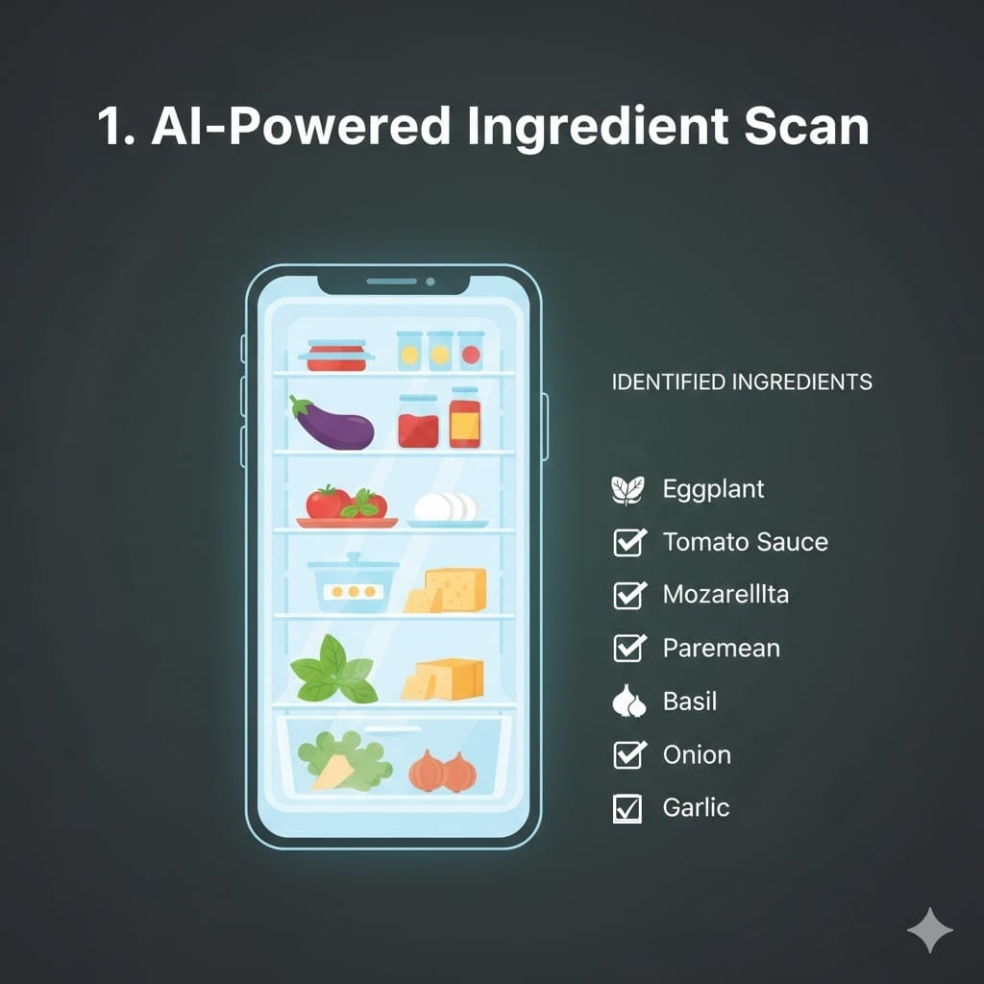
List of features offered by the solution
Instantly identify all items in your fridge or pantry with a single photo. No manual input, just smart vision.

Slide 7
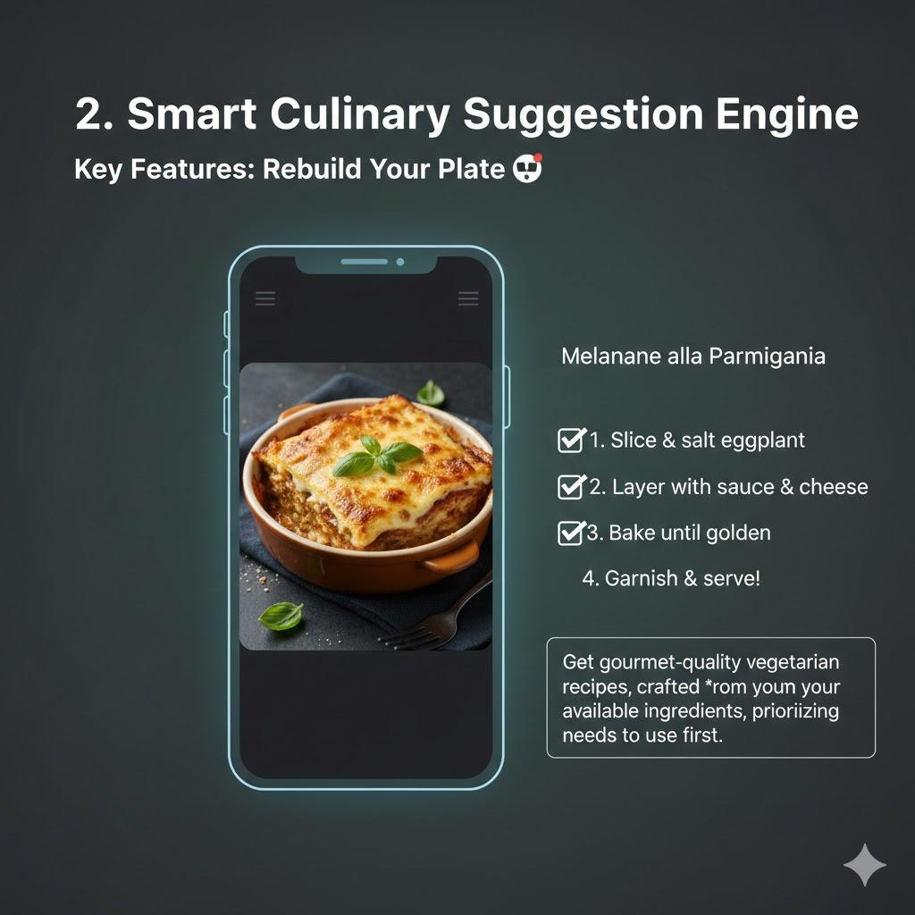
Get gourmet-quality recipes, crafted only from your available ingredients, prioritizing what needs to be used first.

Slide 8
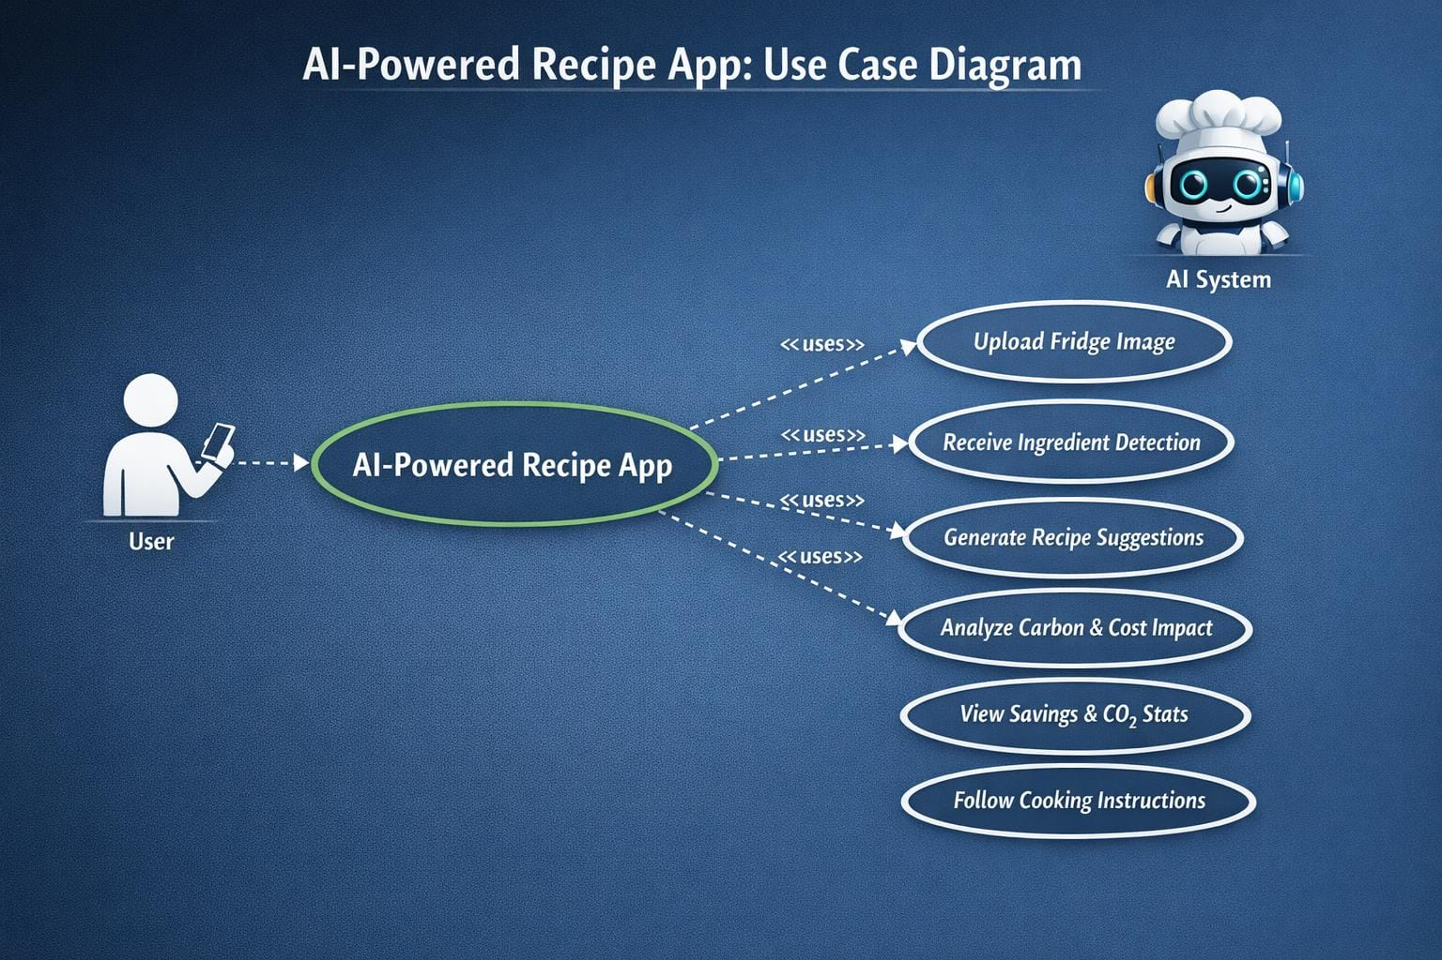
Process flow diagram or Use-case diagram

Slide 9
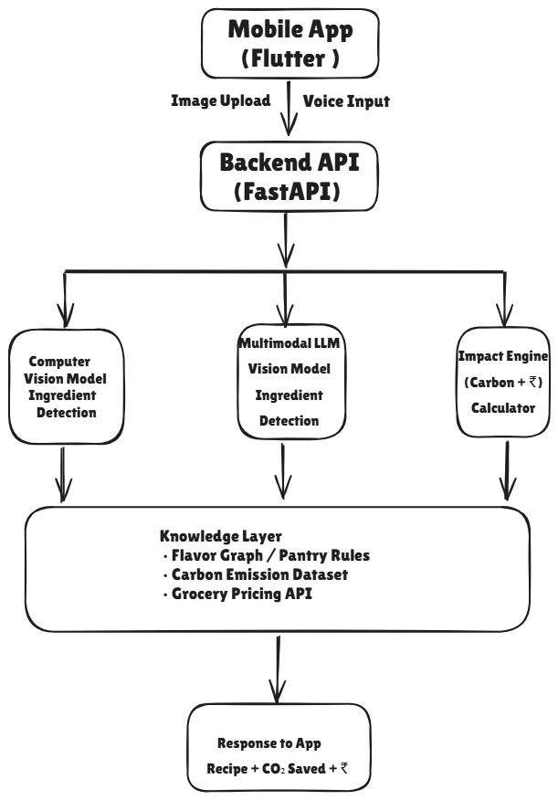
Architecture diagram of the proposed solution:

Slide 10
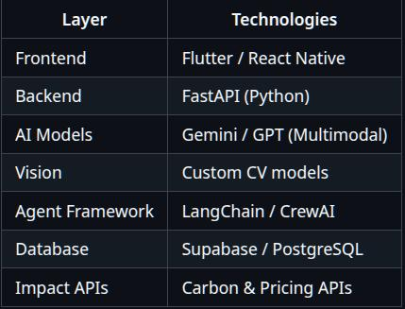
Technologies to be used in the solution:

Slide 11


